Slide 1



Voicebot Speech-To-Text-To-Speech Components-2
Ronny Georgi
Sadaf Yazdanparast
Julius Kaiser
Workshop 3 – Final Presentation

Slide 2
Agenda
1
Wrap-up: Problem Statement
2
Final Results & Realisation Details
3
Final Demo
4
Conclusion

Slide 3
Agenda
1
Wrap-up: Problem Statement
2
Final Results & Realisation Details
3
Final Demo
4
Conclusion

Slide 4


Updated - Problem Statement
Situation in Tourism Industry
Solutions offered through Voicebot
Tourism and hospitality industry are very information-intensive
It demands regular communication with customers who want to be up-to-date with firms offering
they seek this information through websites and other mediums such as phone calls and instant messaging
To maintain communication channels: tourism and hospitality firms spend large sums of money annually on inquiry and desk officers
customer service saves money through bots by automating tasks and unclogging call centers
bots assist users in navigating websites, thus shortening time and assisting in quick decision-making
for train travel: bots can find suitable train connections by gathering information like time, date, destination, and other preferences
For hotel reservation: find hotels within certain location area, with a desired star rating and present user the address of those hotels
after hotel is found → find train to get to hotel
build social relationships with customers, maintain customer confidence in trains and hotel chains

Slide 5
Agenda
1
Wrap-up: Problem Statement
2
Final Results & Realisation Details
3
Final Demo
4
Conclusion

Slide 6




Final Results
 | Difficultness and complexity of initial setup | Intuitiveness of GUI for bot creation | Capability to integrate variety of data & making use of it | Availibility of good understand-dable docu-mentation material with examples | Processing of speech input and voice output | Complex task processing capabilities | API connectivity opportunities
Dialogflow
Rasa
Amazon Lex
Criteria
Framework
Legend: Exceptional Good Average Poor

Slide 7
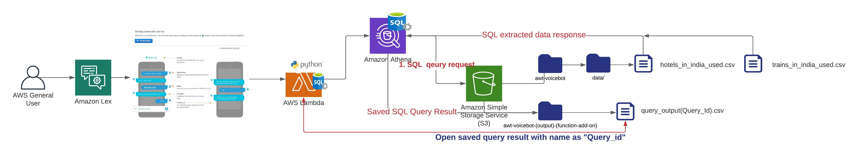
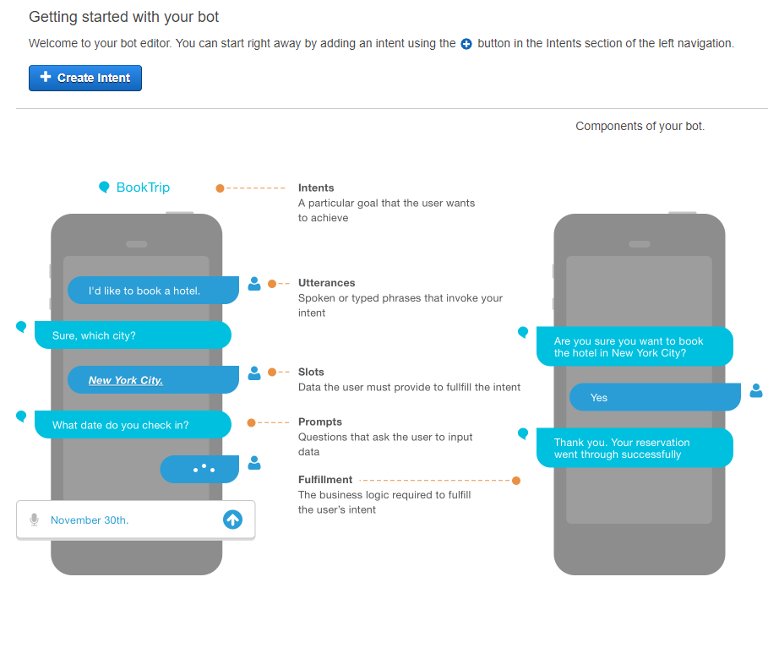
AWS Lex – Travelbot Realisation Details

Slide 8
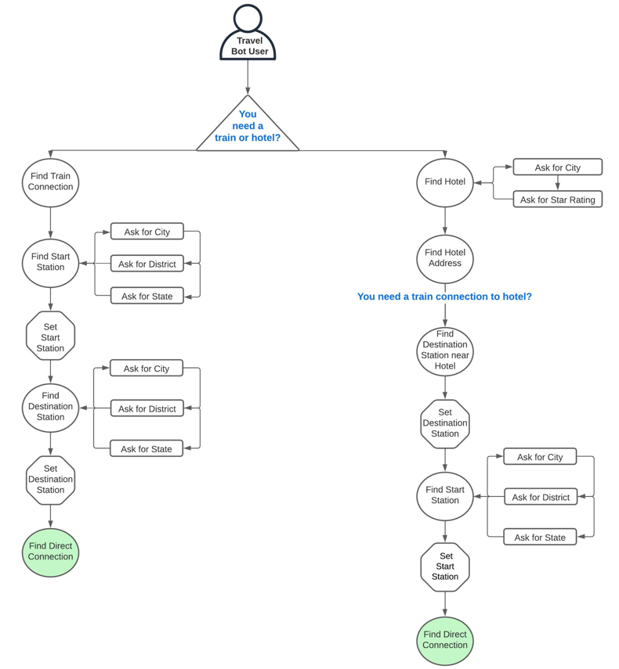
Travelbot – Realisation Details Functionality & Task Overview

Slide 9
Agenda
1
Wrap-up: Problem Statement
2
Final Results & Realisation Details
3
Final Demo
4
Conclusion

Slide 10
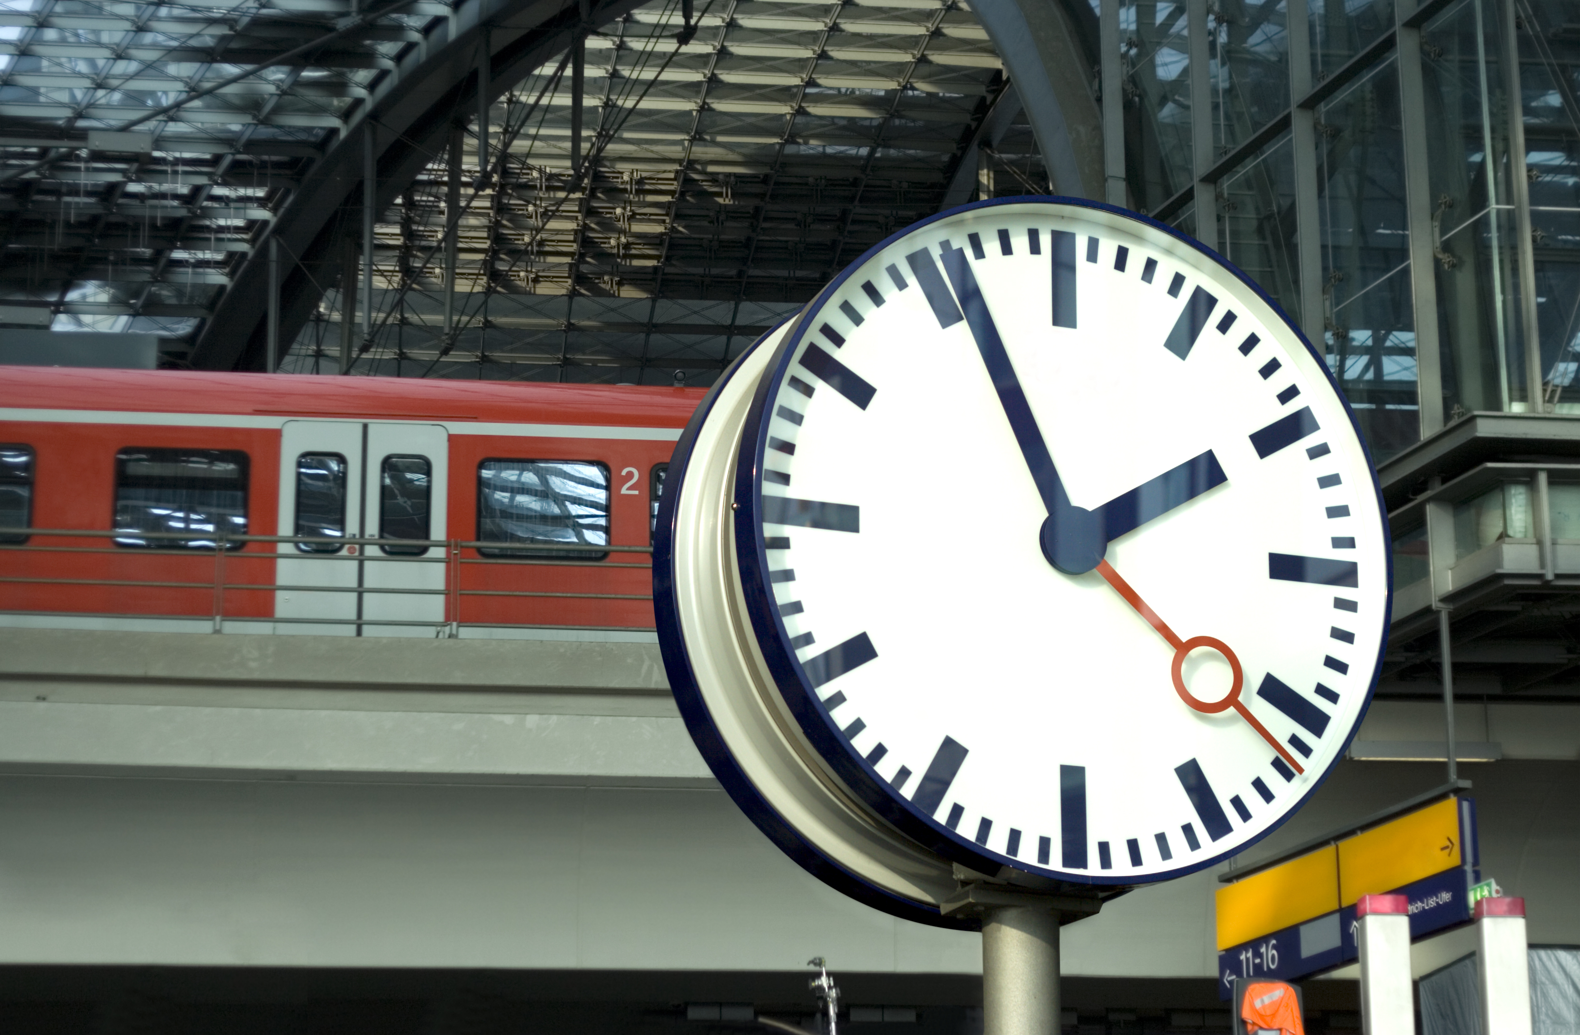
Find Train Connection

Slide 11
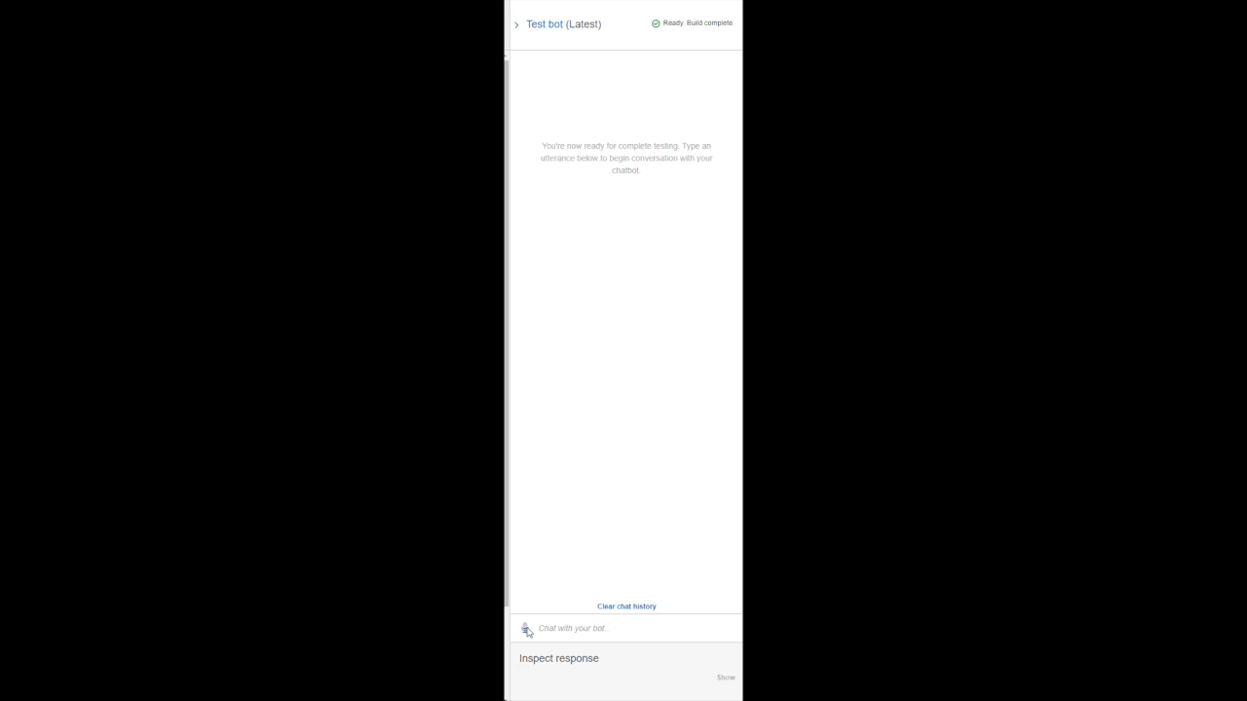
AWS Lex – Demo to find train connection

Slide 12

Find Hotel with Address

Slide 13

Find Train Connection to Get to Hotel

Slide 14
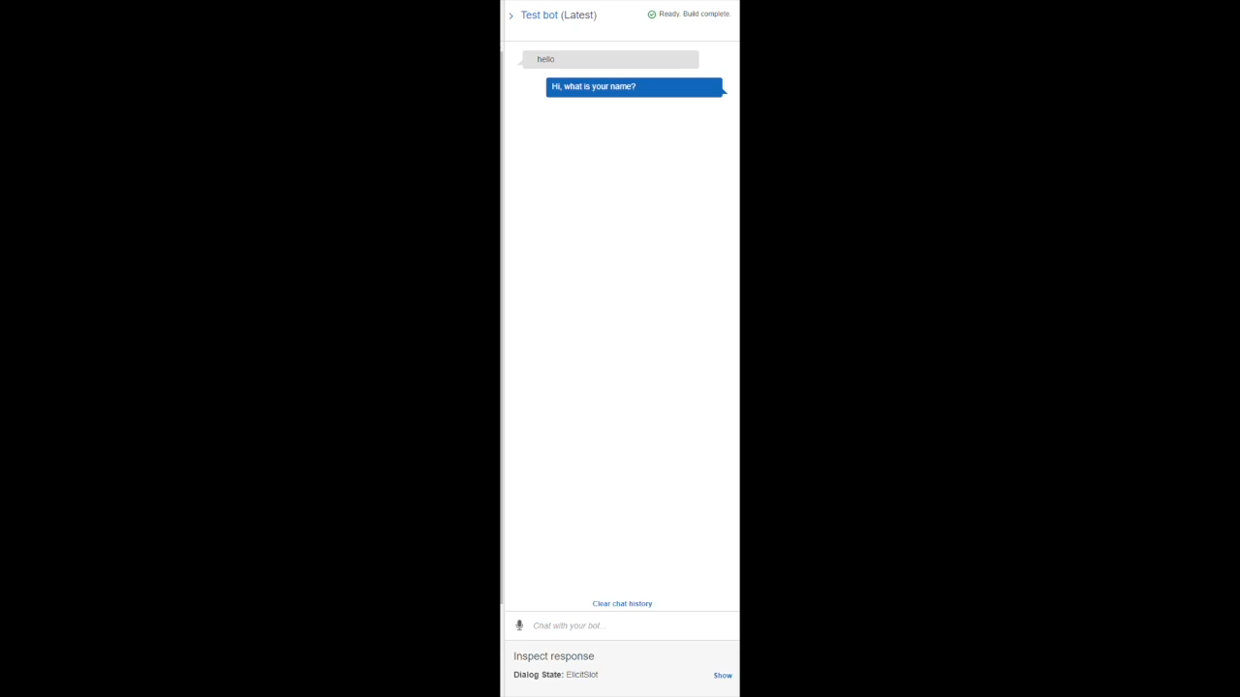
AWS Lex – Demo to find hotel and train to hotel

Slide 15

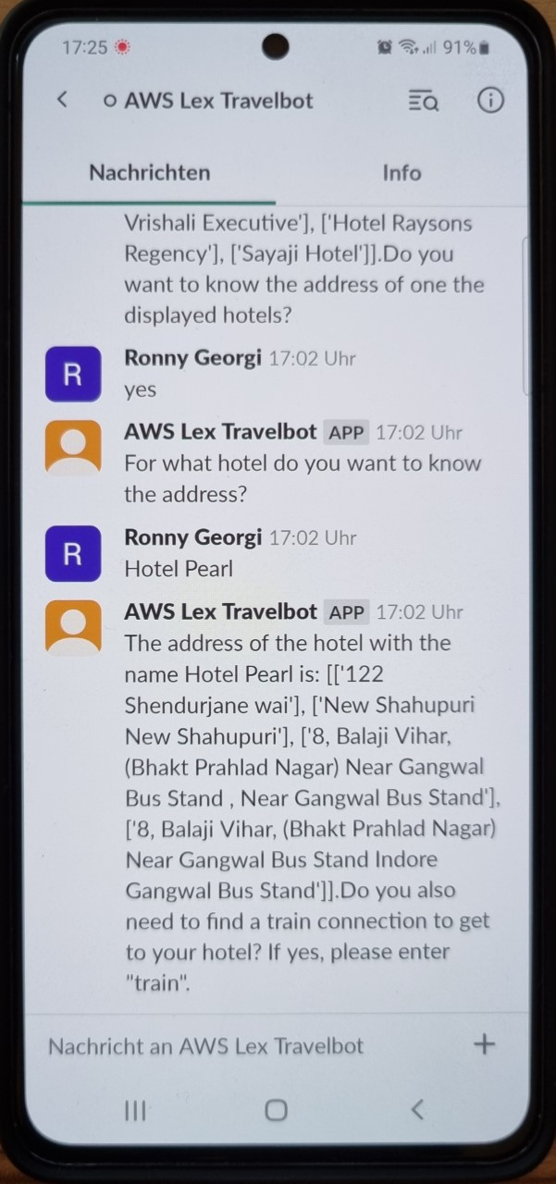
Our Travelbot is also integrated into the Messenger Service:
You can also interact with our Travelbot on your Smartphone via the Slack App
Source: https://logos-world.net/slack-logo/

Slide 16
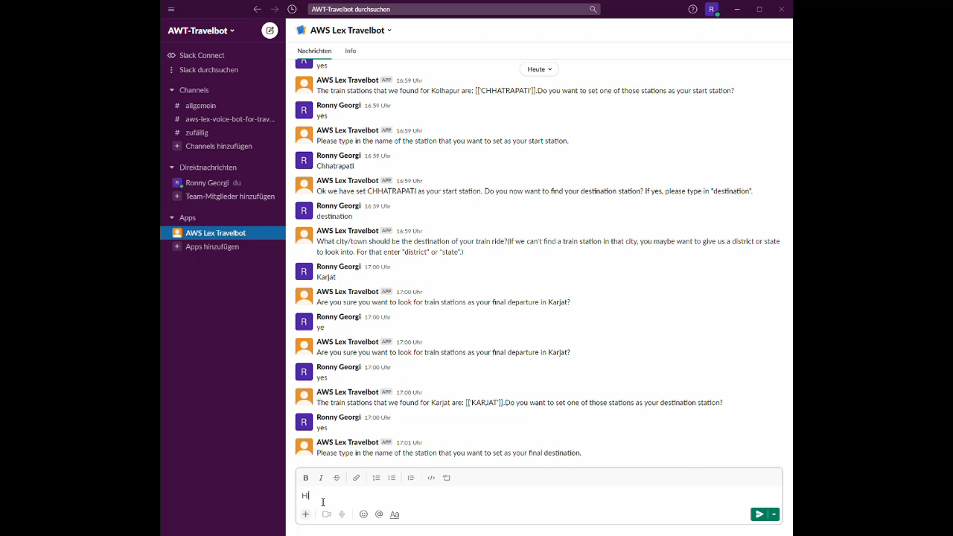
AWS Lex – Demo to find hotel using Slack app

Slide 17
Agenda
1
Wrap-up: Problem Statement
2
Final Results & Realisation Details
3
Final Demo
4
Conclusion

Slide 18
Conclusion
AWS Lex proved to be best framework for our use case:
When availability to large and up-to-date data sets is given:
best possible integration of other technologies
highest degree of customizability
good processing of speech input and output
voicebots can represent a real alternative to human travel agents
their usage could decrease cost while also increasing revenue`
an integration of booking services would even increase their usefulness

Slide 19
THANKS!

